Slide 1

CHILD SAFETY WEARABLE DEVICE WITH IOT SYSTEM
GUIDED BY
DR.T.VAISHNAVI
ASSISTANT PROFESSOR
PRESENTED BY
K.SRIKANTH(VTU21105)
P.SURYA(VTU21198)
S.DURGA SRINIVAS PRASAD(VTU21225)

Slide 2
ABSTRACT
Child safety has become a paramount concern in today's world, with parents seeking ways to monitor their children's movements without infringing on their independence.
Location tracking technology, coupled with range monitoring systems, offers a promising solution to this dilemma.
This abstract discusses the implementation and benefits of such a system.
The proposed system employs GPS-enabled devices, such as wearable trackers, to continuously monitor the child's location.
Parents can set predefined safe zones or ranges using geofencing technology. When the child crosses these boundaries, the system triggers alerts to notify parents immediately, enabling timely intervention if necessary.

Slide 3
ABSTRACT
This project aims to a superior piece of technology designed to ensure the safety of children. It is a wearable device that is equipped with location tracking capabilities, enabling parents or guardians to monitor the child’s whereabouts in real-time.
Additionally, it sends an automatic message to predefined contact ensuring immediate response and assistance.
We made a wearable device that can tell the parents whether the child is within the range or not . The wearable device has a GPS, a GSM, and a Arduino. These things can send a message to the parent’s phone with the kid’s location.

Slide 4
OBJECTIVE
Aim of the Project: Child Safety Wearable Device with Location Tracking IOT system.
Scope of the Project:
Enhancing Parental Peace of Mind :
Discuss how the system aims to provide parents with peace of mind regarding their child's safety.
Explain how real-time location updates and alerts help parents stay informed about their child's whereabouts.
Facilitating Child Independence :
Emphasize the importance of allowing children to explore the world independently.
Explain how location tracking with range monitoring strikes a balance between safety and independence.

Slide 5
OBJECTIVE
Timely Intervention :
Explain how the system alerts parents when the child crosses predefined boundaries.
Discuss the importance of timely intervention in critical situations.
Illustrate scenarios where timely alerts can prevent potential risks or dangers.
Privacy and Security :
Address concerns regarding privacy and data security.
Explain measures taken to ensure secure data transmission and restricted access to location information.
Reassure parents about the confidentiality of their child's location data.

Slide 6
INTRODUCTION
The main purpose of this technology is designed to know the safety of children. It helps parents or guardians to keep track of their children’s location and well-being, and to act quickly in case of an emergency.
It is a wearable device that is equipped with location tracking capabilities, allowing parents or guardians to monitor the child’s whereabouts in real-time. Additionally, it sends an automatic message to predefined contacts in case the child goes out of the boundary & ensuring immediate response and assistance.

Slide 7
LITERATURE SURVEY
S.NO | TITLE | AUTHOR | ABSTRACT | PROBLEM
1 | I want to know where my child is at all times’ – field study of a location-aware safety service for schoolchildren | Jhuhani litakari | The paper presents findings from a long-term field study on a location-aware safety service for schoolchildren, involving four service components co-designed with end-users. | challenges lie in ensuring alignment with all stakeholders' needs and integrating the system seamlessly into everyday life.
2 | Child Safety & Tracking Management System by Using GPS, Geo-Fencing & Android Application | Mika hilukala | This paper proposes a smartphone-based child safety model, ensuring live tracking and emergency messaging for parents' peace of mind, validated on the Android platform | parental concerns by proposing a smartphone-based child safety model emergency messaging capabilities, validated on the Android

Slide 8
BLOCK DIAGRAM
GPS MODULE
ARDUINO UNO
GSM MODULE
Google Maps
Alert SMS with Location
Mobile

Slide 9
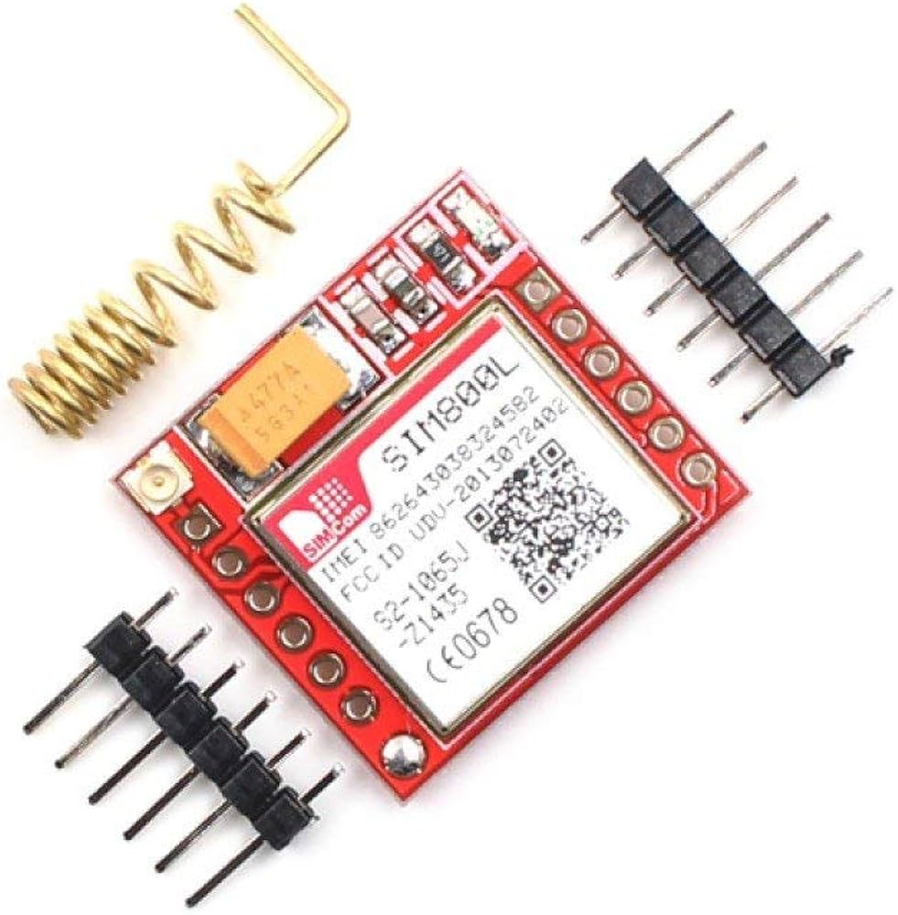
GSM module:-
A GSM (Global System for Mobile Communications) module is a specialized hardware device that enables communication between a device or system and a GSM network. It allows devices to transmit and receive data via mobile networks, facilitating functionalities such as sending and receiving SMS messages, making voice calls, and accessing data services like internet connectivity.

Slide 10
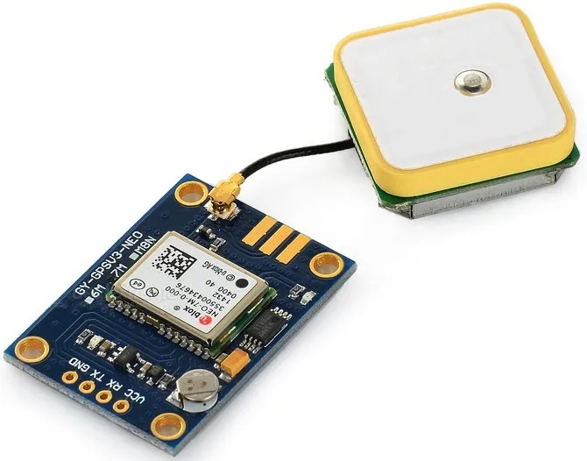
GPS module:-
A GPS (Global Positioning System) module is a hardware device that receives signals from satellites orbiting the Earth to determine the device's precise geographic location. These modules are commonly used in a wide range of applications, including navigation systems, vehicle tracking, asset tracking, geotagging in photography, and various IoT applications requiring location-based.

Slide 11
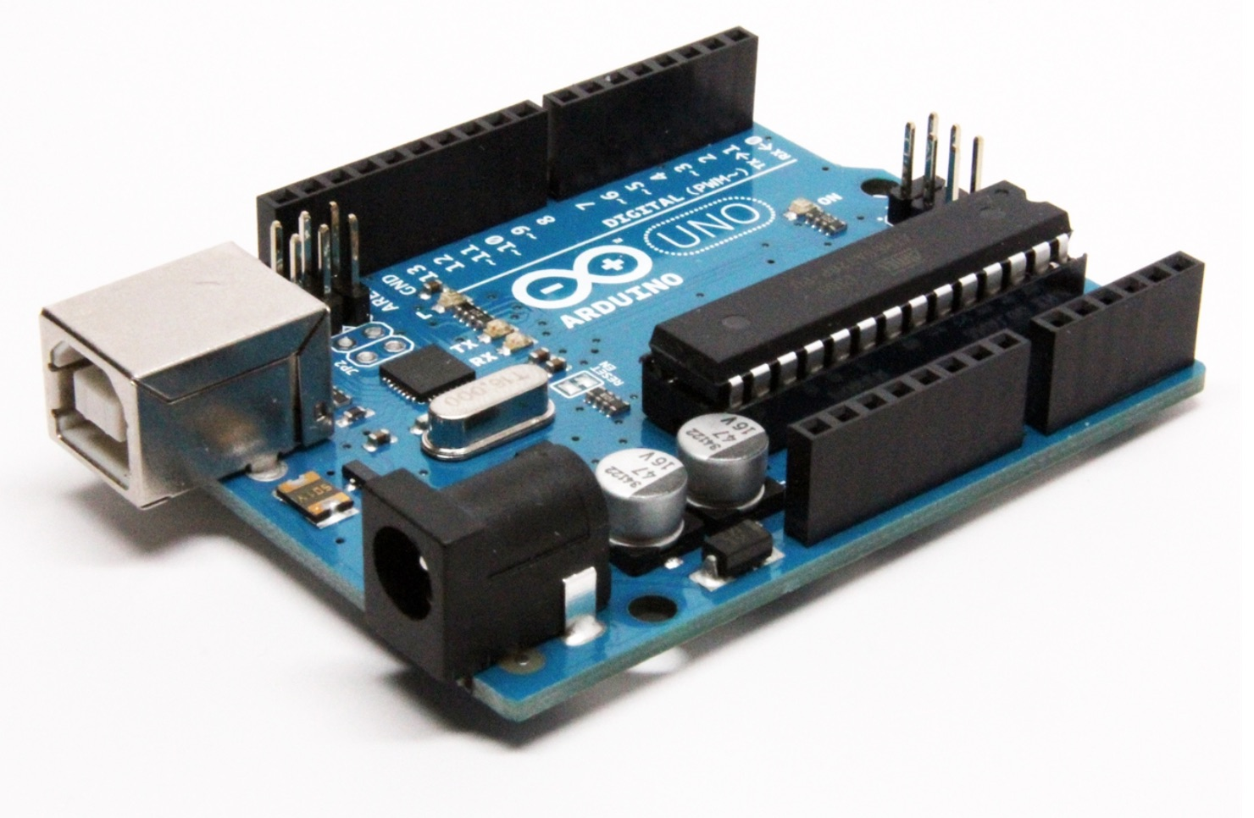
AUDUINO UNO:-
The Arduino Uno is a popular open-source microcontroller board based on the ATmega328P microcontroller. It is part of the Arduino family of boards, which are designed for prototyping and DIY electronics projects.The Arduino Uno is widely used for a variety of projects, including robotics, home automation, wearable technology, IoT (Internet of Things) devices, and educational purposes due to its ease of use, versatility, and large community of developers and enthusiasts.

Slide 12
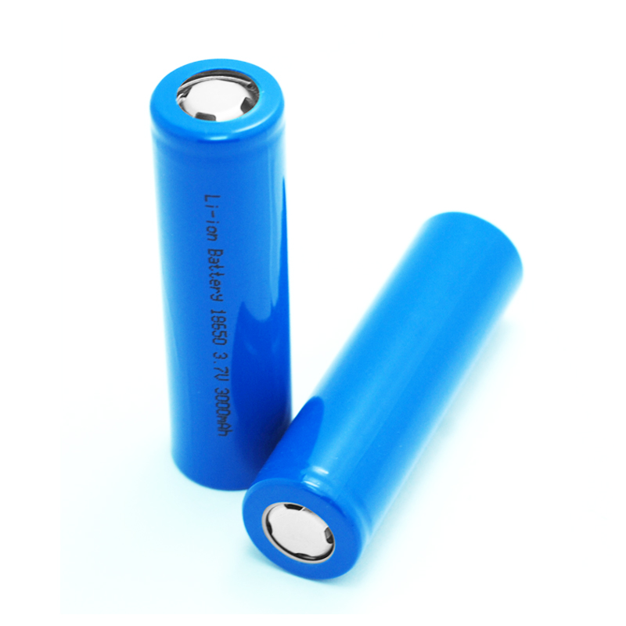
BATTERY:-
Rechargeable lithium-ion batteries are widely used in various applications due to their high energy density, lightweight, and long cycle life. rechargeable lithium-ion batteries play a crucial role in powering modern electronic devices and systems, offering improved performance, reliability, and sustainability compared to traditional disposable batteries.

Slide 13
Methodology
The wearable device is worn by the child. The GPS module updates the location of the child and sends it to the GSM module, which in turn sends it to the contacts via SMS at regular intervals.
If such a change is detected, the GPS sends a signal to the microcontroller, which activates the GSM module.
The GSM module sends an emergency message to the contacts along with the location of the child. The contacts can then take appropriate action to help the child.

Slide 14
DESIGN FLOW
1. Initialization:
Upon powering on the device, it initializes and establishes a connection with GPS satellites and the cellular network for data transmission.
2. Geofence Setup:
Parents or caregivers set up geofences or safe zones using a dedicated mobile application or web interface.
Parameters such as the center coordinates of the zone and the radius are configured according to the desired range(Max:500m).

Slide 15
DESIGN FLOW
3. Location Tracking:
The device continuously receives GPS signals to determine its current location.
Location data is periodically transmitted to the server via the cellular network.
4. Boundary Monitoring:
The device compares the current location with predefined geofences to check if the child has crossed any boundaries.
If the child's location is outside the designated safe zone, the device triggers an alert.

Slide 16
DESIGN FLOW
5. Alert Generation:
Upon detecting a boundary breach, the device generates an alert signal.
The alert may include information such as the child's current location, and a notification message.
6. Alert Transmission:
The device sends the alert signal to the server for processing and forwarding to the designated recipients.
Alerts can be transmitted via SMS, to the parents' or caregivers' mobile devices.

Slide 17
DESIGN FLOW
7. Alert Reception:
Parents or caregivers receive the alert on their mobile devices through default sms application on their mobile.
The alert is accompanied by relevant information for further action.
8. Continuous Monitoring:
The device continues to track the child's location and monitor boundaries for any further breaches.
Alerts are generated and transmitted as needed to ensure ongoing safety

Slide 18
Hardware/Software Used
Hardware Components:-
GPS module
GSM module
Microcontroller – Arduino UNO
Battery
Jumper Wires
Bread Board
Software Components:-
Arduino IDE
Default SMS Application.

Slide 19
code
float initialLatitude = 13.191747;
float initialLongitude = 80.105434;
float latitude, longitude;
//--------------------------------------------------------------
void getGps(float& latitude, float& longitude);
/*****************************************************************************************
* setup() function
*****************************************************************************************/
void setup()
{
//--------------------------------------------------------------
//Serial.println("Arduino serial initialize");
Serial.begin(9600);
//--------------------------------------------------------------
//Serial.println("SIM800L serial initialize");
sim800.begin(9600);
//--------------------------------------------------------------
//Serial.println("NEO6M serial initialize");
neogps.begin(9600);
//--------------------------------------------------------------
pinMode(BUZZER, OUTPUT);
//--------------------------------------------------------------
#include <SoftwareSerial.h>
#include <AltSoftSerial.h>
#include <TinyGPS++.h>
//--------------------------------------------------------------
//enter your personal phone number to receive sms alerts.
//phone number must start with country code.
const String PHONE = "+91 YOUR MOBILE NUMBER ";
//--------------------------------------------------------------
//GSM Module RX pin to Arduino 3
//GSM Module TX pin to Arduino 2
#define rxPin 2
#define txPin 3
SoftwareSerial sim800(rxPin,txPin);
//--------------------------------------------------------------
//GPS Module RX pin to Arduino 9
//GPS Module TX pin to Arduino 8
AltSoftSerial neogps;
TinyGPSPlus gps;
//--------------------------------------------------------------
// Size of the geo fence (in meters)
const float maxDistance = 30;
//--------------------------------------------------------------

Slide 20
code
void loop()
{
//--------------------------------------------------------------
getGps(latitude, longitude);
//--------------------------------------------------------------
float distance = getDistance(latitude, longitude, initialLatitude, initialLongitude);
//--------------------------------------------------------------
Serial.print("Latitude= "); Serial.println(latitude, 6);
Serial.print("Lngitude= "); Serial.println(longitude, 6);
Serial.print("initialLatitude= "); Serial.println(initialLatitude, 6);
Serial.print("initialLngitude= "); Serial.println(initialLongitude, 6);
Serial.print("current Distance= "); Serial.println(distance);
//--------------------------------------------------------------
/*****************************************************************************************
* getDistance() function
*****************************************************************************************/
// Calculate distance between two points
float getDistance(float flat1, float flon1, float flat2, float flon2) {
// Variables
float dist_calc=0;
float dist_calc2=0;
sim800.println("AT"); //Check GSM Module
delay(1000);
sim800.println("ATE1"); //ON
delay(1000);
sim800.println("AT+CPIN?"); //Check SIM ready
delay(1000);
sim800.println("AT+CMGF=1"); //SMS text mode
delay(1000);
sim800.println("AT+CNMI=1,1,0,0,0"); /// Decides how newly arrived SMS should be handled
delay(1000);
//AT +CNMI = 2,1,0,0,0 - AT +CNMI = 2,2,0,0,0 (both are same)
//--------------------------------------------------------------
delay(20000);
buzzer_timer = millis();
}
/*****************************************************************************************
* loop() function
*****************************************************************************************/

Slide 21
code
float diflat=0;
float diflon=0;
// Calculations
diflat = radians(flat2-flat1);
flat1 = radians(flat1);
flat2 = radians(flat2);
diflon = radians((flon2)-(flon1));
dist_calc = (sin(diflat/2.0)*sin(diflat/2.0));
dist_calc2 = cos(flat1);
dist_calc2*=cos(flat2);
dist_calc2*=sin(diflon/2.0);
dist_calc2*=sin(diflon/2.0);
dist_calc +=dist_calc2;
dist_calc=(2*atan2(sqrt(dist_calc),sqrt(1.0-dist_calc)));
dist_calc*=6371000.0; //Converting to meters
return dist_calc;
}
/*****************************************************************************************
* getGps() Function
************************************************************************/
void getGps(float& latitude, float& longitude)
{
// Can take up to 60 seconds
boolean newData = false;
for (unsigned long start = millis(); millis() - start < 2000;){
while (neogps.available()){
if (gps.encode(neogps.read())){
newData = true;
break;
}
}
}
if (newData) //If newData is true
{
latitude = gps.location.lat();
longitude = gps.location.lng();
newData = false;
}
else {
Serial.println("No GPS data is available");
latitude = 0;
longitude = 0;
}
}

Slide 22
code
/*****************************************************************************************
* sendAlert() function
*****************************************************************************************/
void sendAlert()
{
//return;
String sms_data;
sms_data = "Alert! The Child is outside the fense.\r";
sms_data += "http://maps.google.com/maps?q=loc:";
sms_data += String(latitude) + "," + String(longitude);
//return;
sim800.print("AT+CMGF=1\r");
delay(1000);
sim800.print("AT+CMGS=\""+PHONE+"\"\r");
delay(1000);
sim800.print(sms_data);
delay(100);
sim800.write(0x1A); //ascii code for ctrl-26 //sim800.println((char)26); //ascii code for ctrl-26
delay(1000);
Serial.println("SMS Sent Successfully.");
}

Slide 23
Timeline Plan
S.No | Project Activity | Description | Date of completion (or) Week number
1 | Literature Survey | Collecting journals and conference paper relevant to the project title | 27/1/24 to 2/2/24
2 | Design | Identifying the problem in existing system and design a proposed system | 3/2/24 to 9/2/24
3 | Coding/Implementation | 1.Identify the suitable coding 2.Run the embedded tool chain(compilation ,object code ,debugging and executing) steps in the software IDE | 12/2/24 to 17/2/24
4 | Analysis | Integrating the software to the hardware | 19/2/24 to 24/2/24
5 | Results and discussion | Checking the outputs with threshold value | 26/2/24 to 2/3/24
6 | Documentation | Report preparation and publication paper work | 4/3/24 to 9/3/24
7 | Paper publication | Presenting conference or submitting paper to the relevant journal | 11/3/24 to till final review date

Slide 24
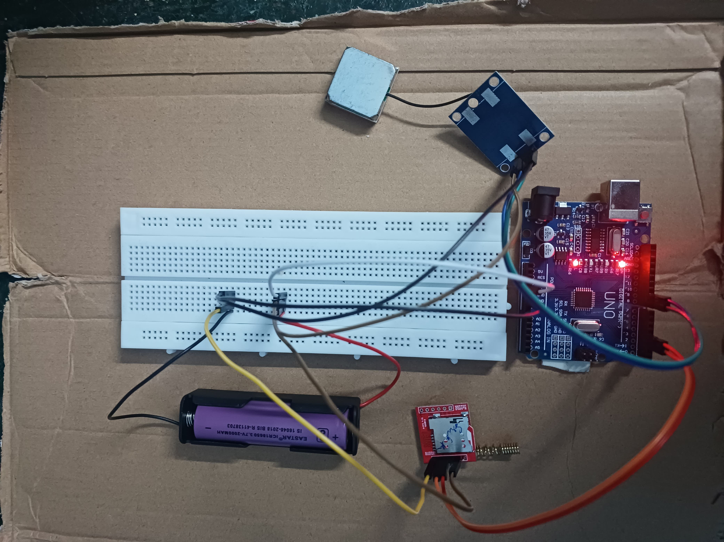
Circuit:-

Slide 25
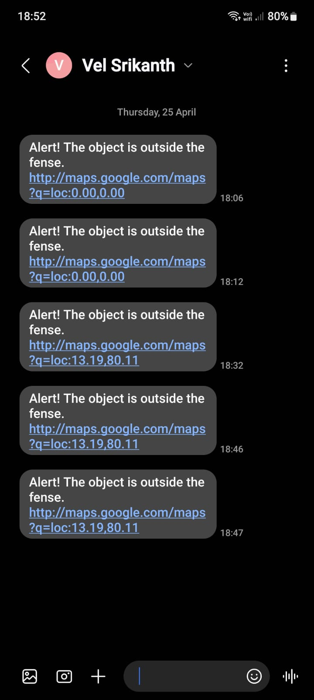
output:-
Alert Message With GPS Location:

Slide 26
References
1. Benisha, M., Prabu, R. T., Gowri, M., Vishali, K., Anisha, M., Chezhiyan, P., & Elliot, C.
J. (2021, February). Design of wearable device for child safety. In 2021 Third International
Conference on Intelligent Communication Technologies and Virtual Mobile Networks (ICICV)
(pp. 1076-1080). IEEE.
2. Aliyu, M. B., Amr, A., & Ahmad, I. S. (2022). Anomaly detection in wearable location trackers
for child safety. Microprocessors and Microsystems, 91, 104545.
3. Tunggadewi, E. A., Agustin, E. I., & Yunardi, R. T. (2021). A smart wearable device based
on internet of things for the safety of children in online transportation. Indonesian Journal of
Electrical Engineering and Computer Science, 22(2), 708-716.
4. Agrawal, N., Kumar, R., & Tapaswi, S. (2024, January). Improved Child Safety Using Edge
Fog-Cloud Enabled Smart IoT Wearable Device: An Architecture. In 2024 16th International
Conference on COMmunication Systems & NETworkS (COMSNETS) (pp. 61-66). IEEE.

Slide 27
5. Zahilah, R., & Zaharan, S. Z. (2022). EyeKids: Real-time tracking and monitoring system for
child safety. International Journal of Innovative Computing, 12(2), 1-8.
6. BANDA, P. J., & MULEPA, J. (2023). INTELLIGENT CHILD MONITORING SAFETY
SYSTEM. I-Manager’s Journal on Mobile Applications & Technologies, 10(2).
7. Gong, X. X., Daronovna, R. K., Wong, A. H., & JosephNg, P. S. (2021). Where Are You? Track
ing Kid Nightmare!. Turkish Journal of Computer and Mathematics Education (TURCOMAT),
12(14), 946-958.
8. Revathi, K. P., & Manikandan, T. (2022). IoT based shrewd monitoring framework for children
safety. ECS Transactions, 107(1), 13967.
9. Shamuri, M. N., & Alias, R. (2021). Design of Tracking System for Kids. Evolution in Electrical
and Electronic Engineering, 2(2), 385-392.

Slide 28
Thank you

